Slide 2



Slide 4


Slide 6

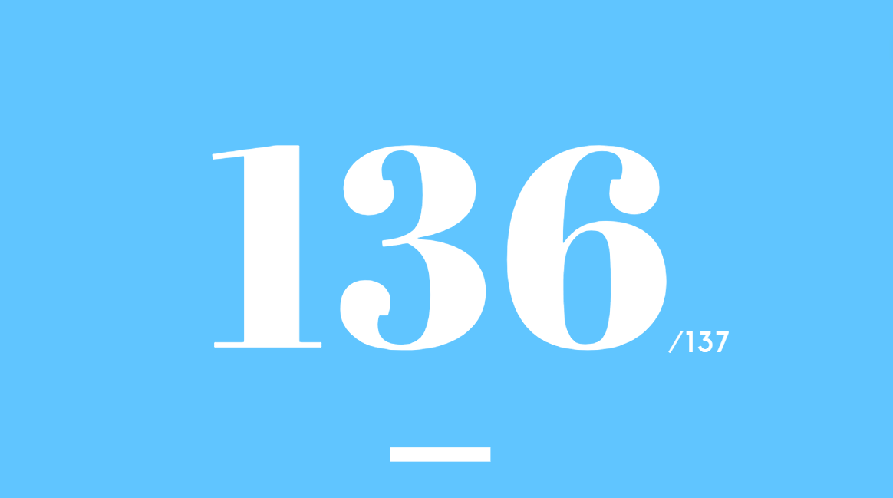

Slide 8
CNN: Nations Ranked Lower for Happiness

Slide 9

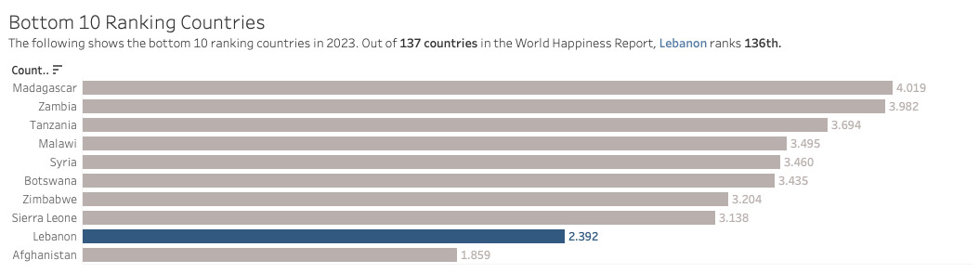

Bottom 10 Ranking Countries

Slide 10
Bottom 10 Ranking Countries

Slide 11
Bottom 10 Ranking Countries

Slide 12
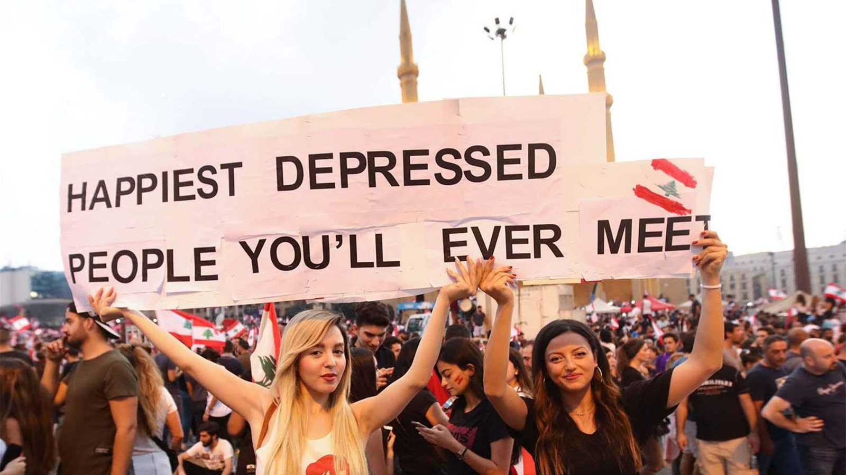

Slide 13


Happiness score

Slide 14
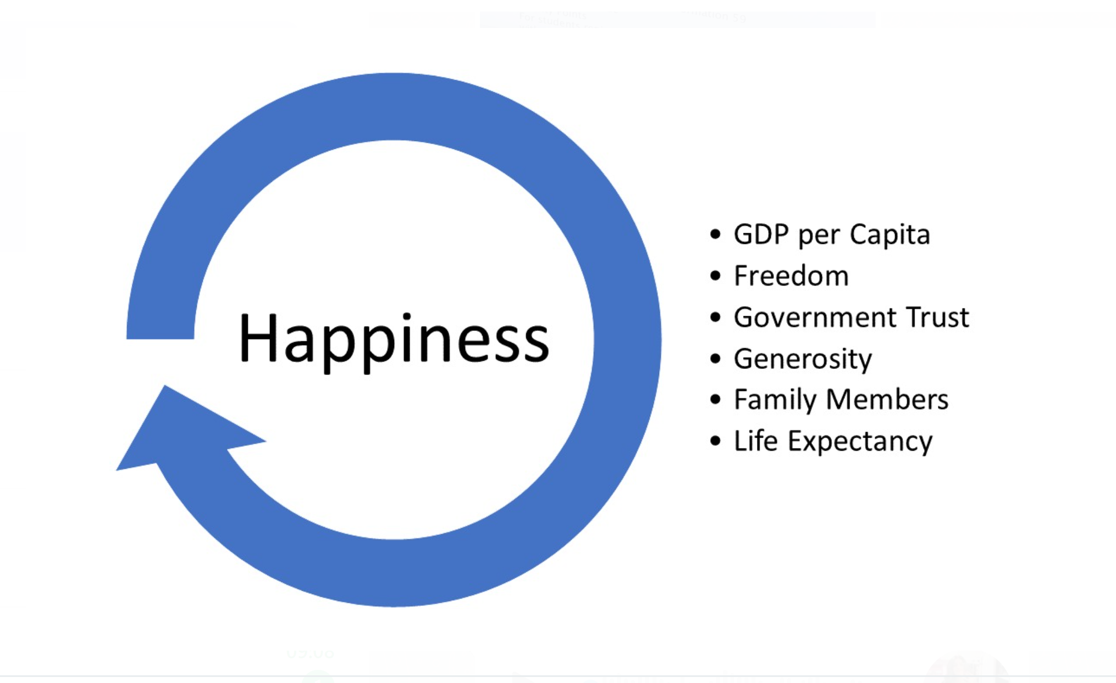

Slide 15
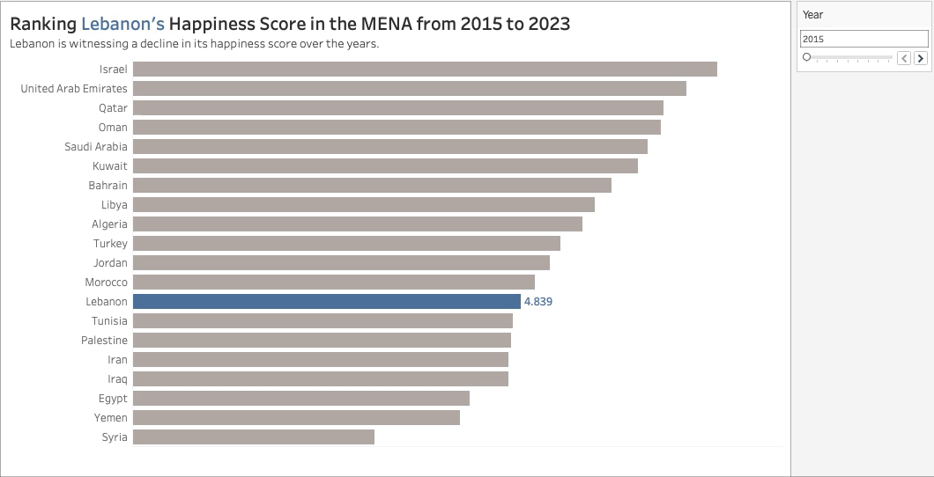








Lebanon is witnessing a decline in its happiness score over the years.

Slide 16
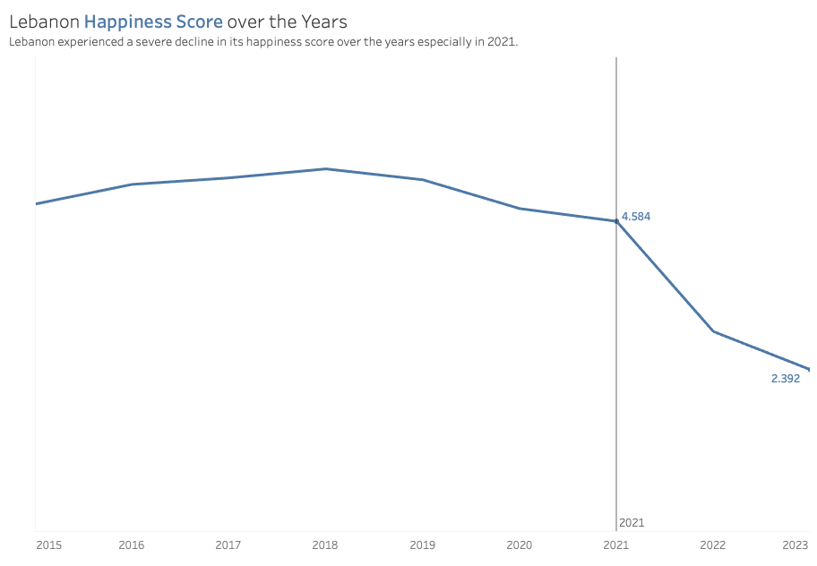
Lebanon Happiness Score over the Years

Slide 17
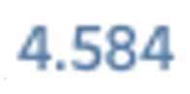


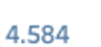


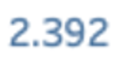

Lebanon Happiness Score over the Years
Lebanon experienced a severe decline in its happiness score over the years especially in 2021.

Slide 18


Slide 19

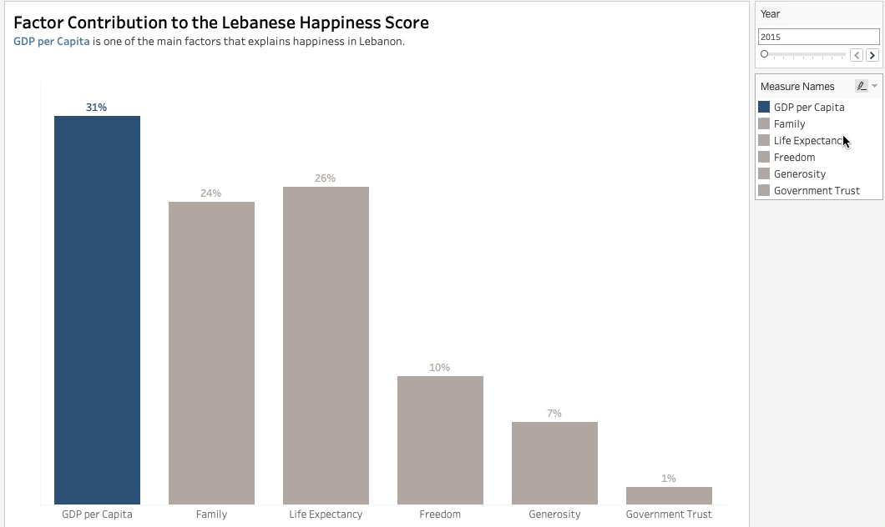


Slide 20
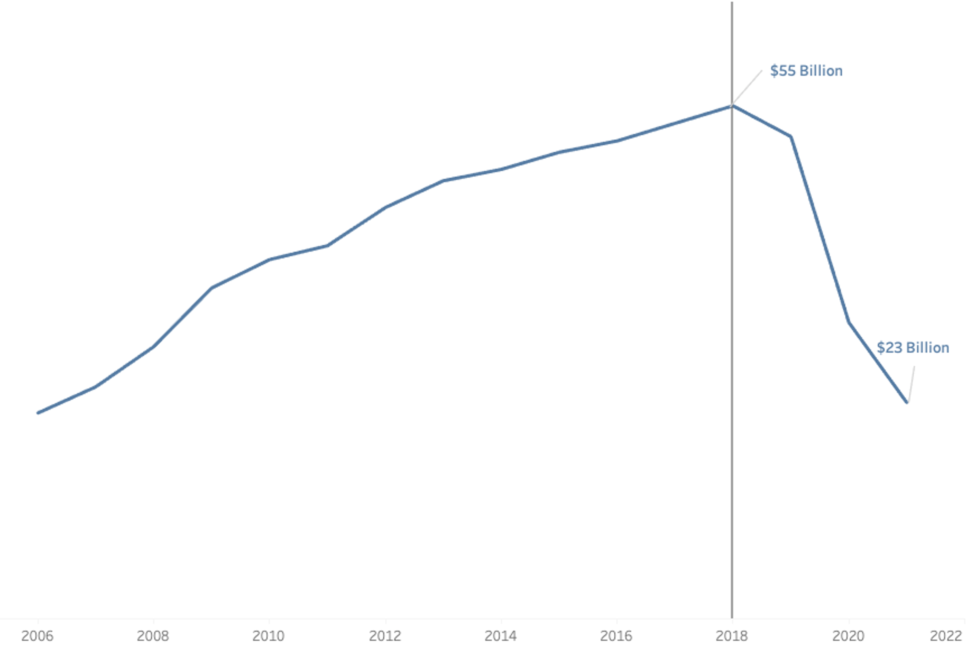

Lebanon’s GDP over the years

Slide 21

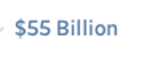

Lebanon’s GDP over the years
Lebanon’s GDP decreased in its happiness score over the years especially from 2018 till 2021.

Slide 22
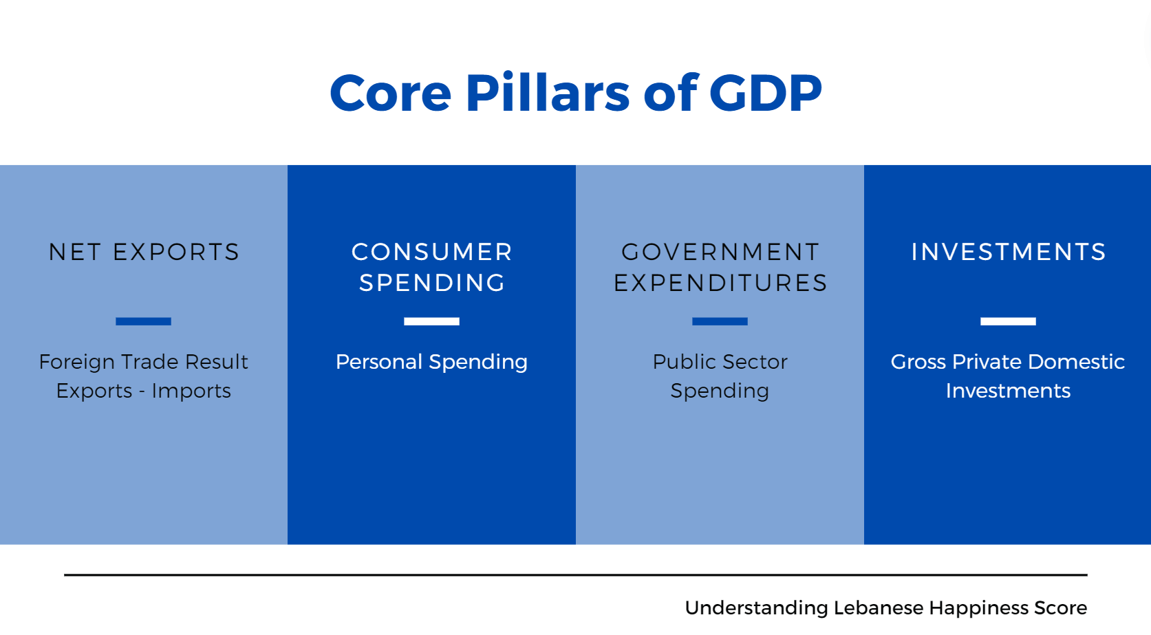

Slide 23



Slide 24
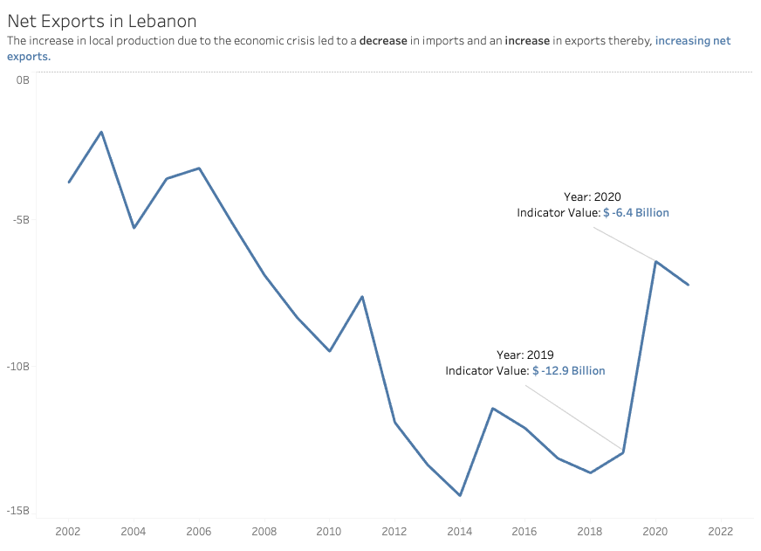


Net Exports
oip98ytuydgh

Slide 25


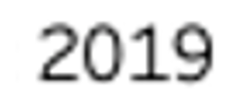

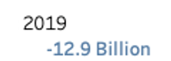

Net Exports

Slide 26

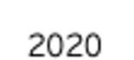

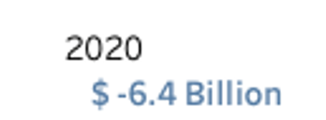

Net Exports
The increase in local production due to the economic crisis led to a decrease in imports and an increase in exports thereby, increasing net exports.

Slide 28
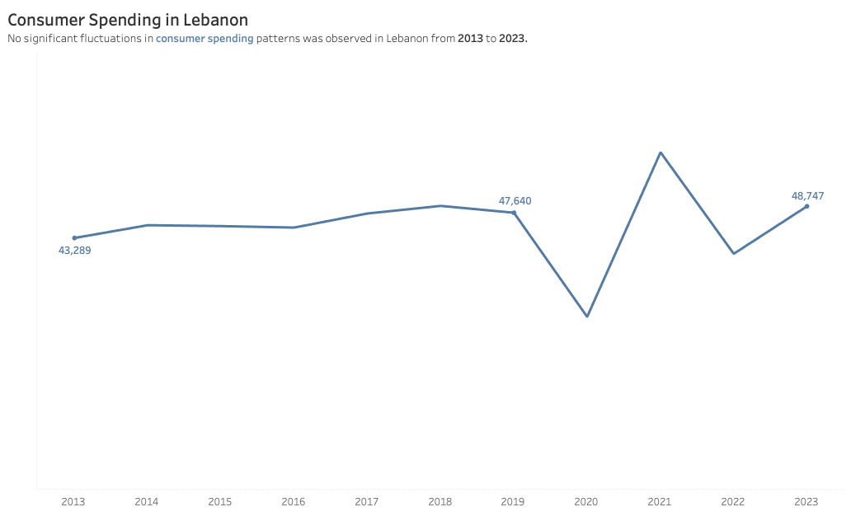

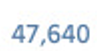
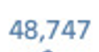


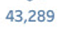
Consumer Spending

Slide 29
Consumer Spending

Slide 30

Consumer Spending
Due to government subsidies, prices in dollars decreased between 2019 and 2020.
Afterwards, the removal of these subsidies caused prices to regulate and adjust back to their previous values.

Slide 31
Consumer Spending
No significant fluctuations in consumer spending patterns was observed in Lebanon from 2013 to 2023.

Slide 33
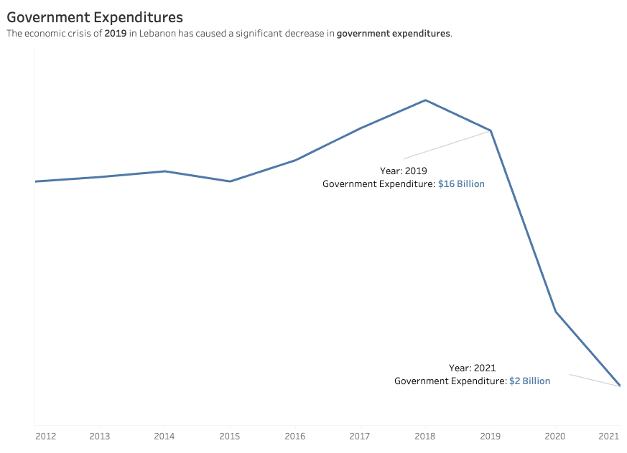

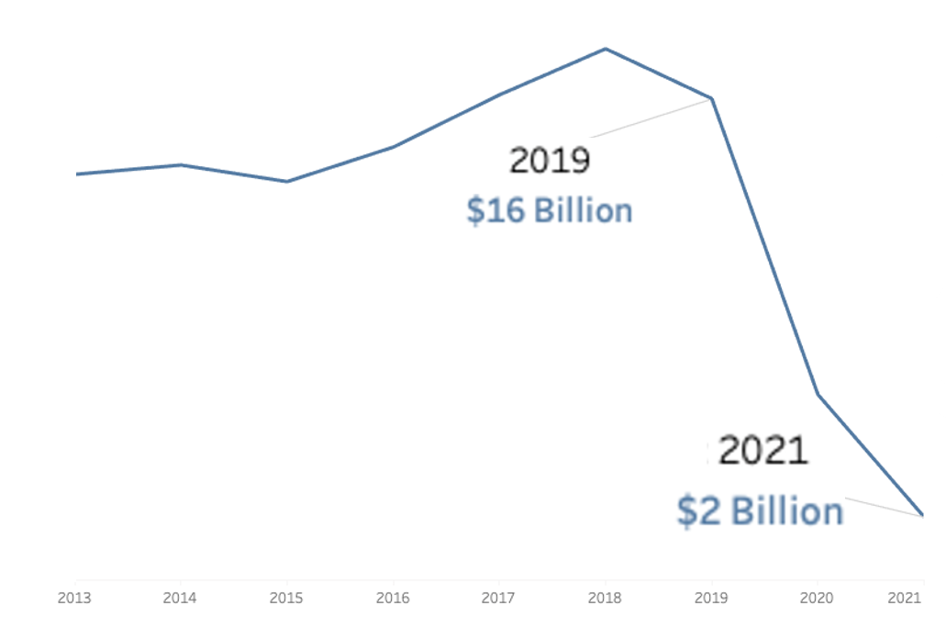



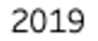
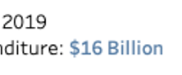

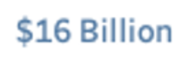



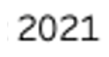
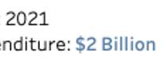
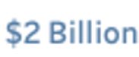
Government Expenditures

Slide 34
Government Expenditures

Slide 35
Government Expenditures
The economic crisis of 2019 in Lebanon has caused a significant decrease in government expenditures.

Slide 37
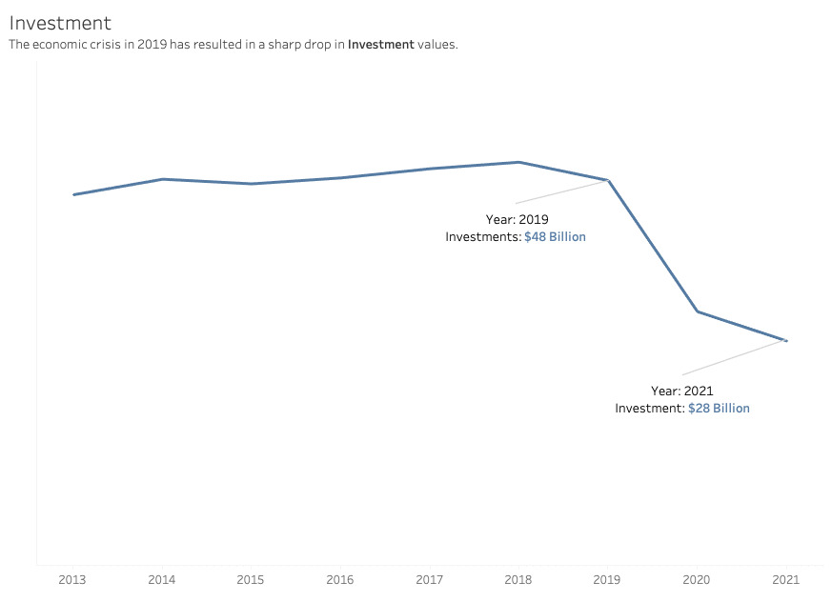
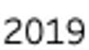


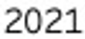
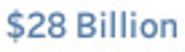
Investment

Slide 38
Investment
The economic crisis in 2019 has resulted in a sharp drop in Investment values.

Slide 40

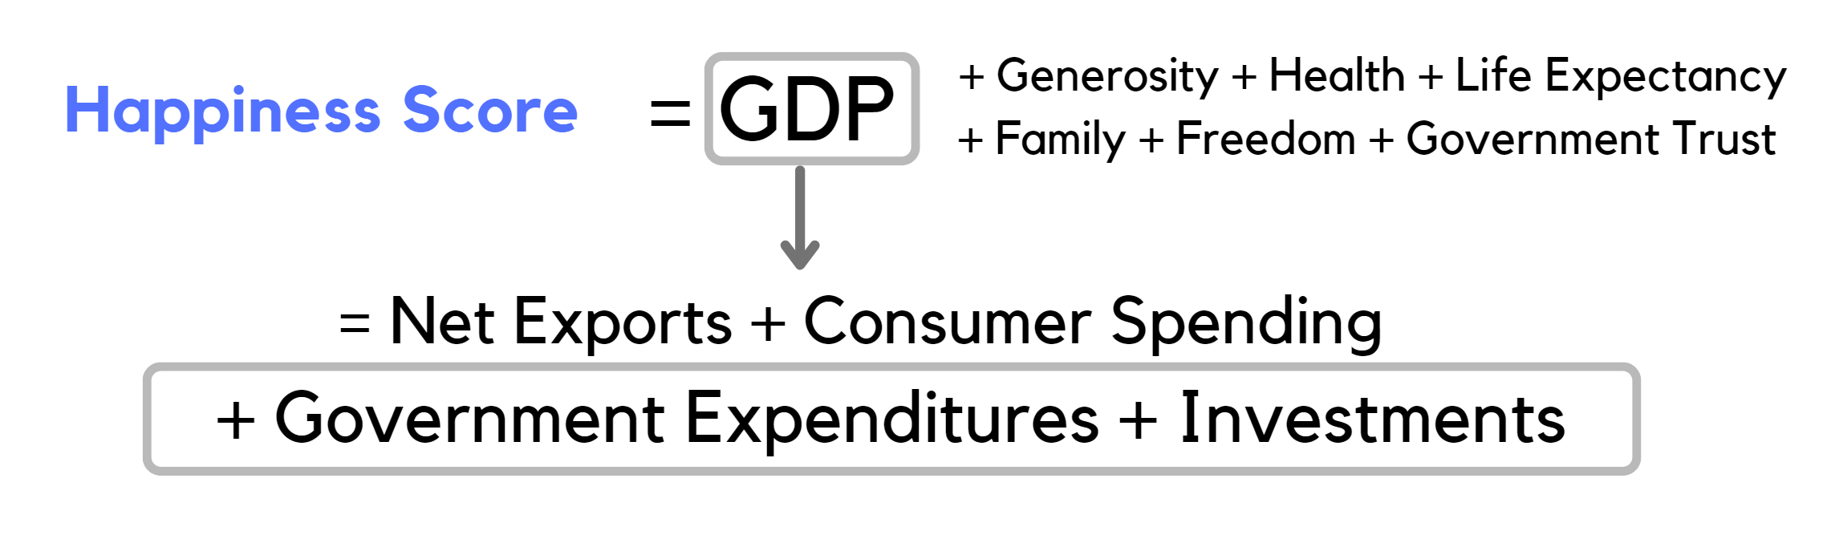


Slide 43
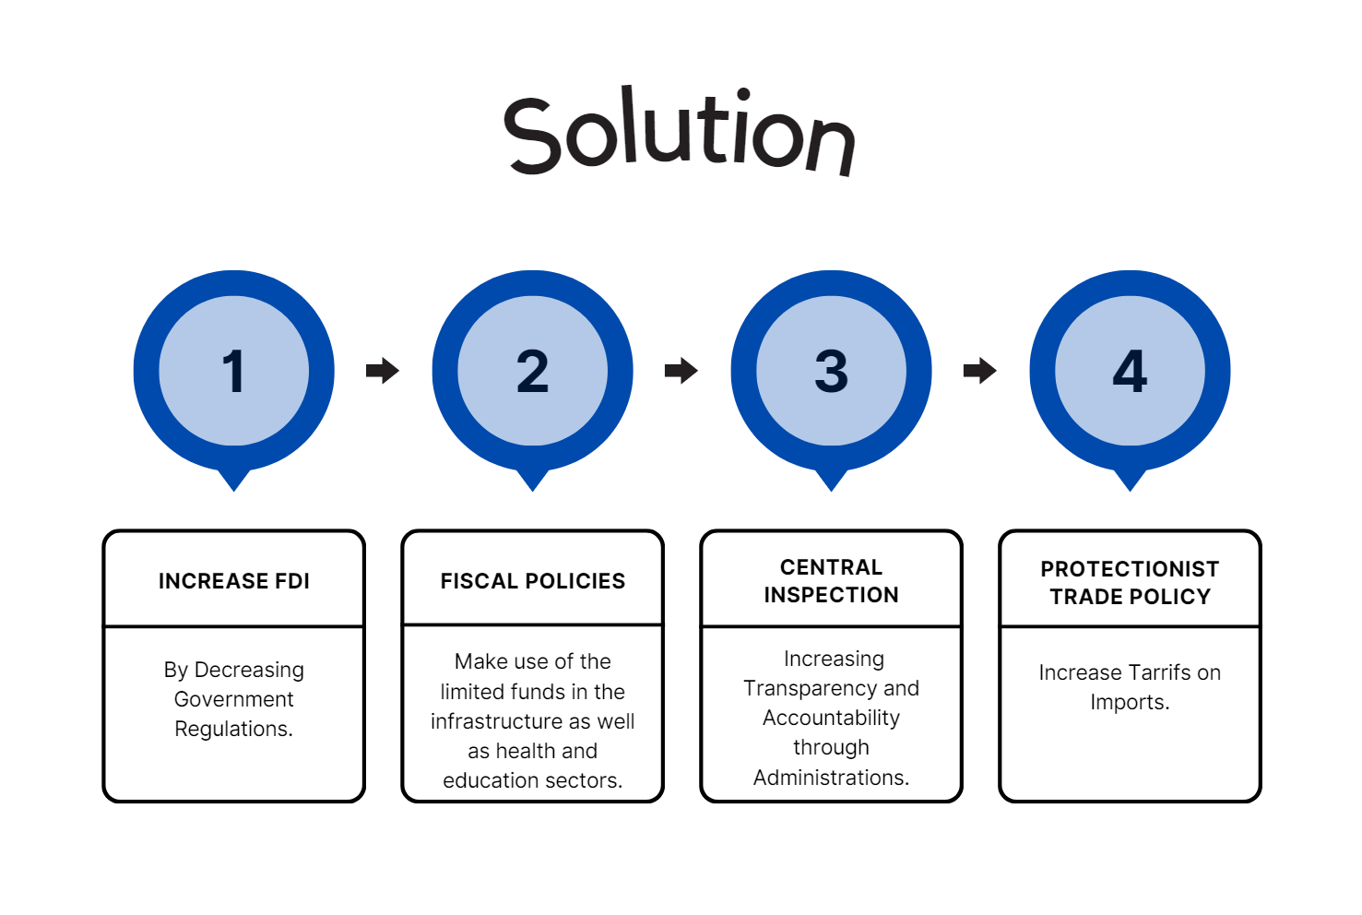


Slide 48
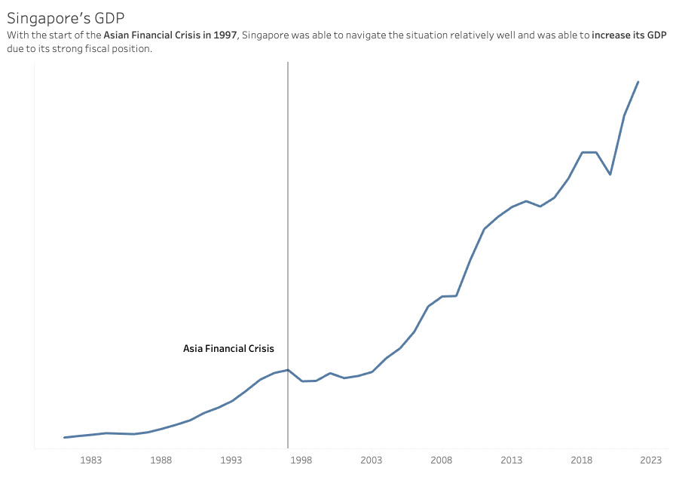

Singapore’s GDP

Slide 49
Singapore’s GDP
Singapore was able to navigate the situation relatively well and was able to increase its GDP due to its strong fiscal position.

Slide 51


